Slide 1
Peer Review for MATLAB Functions
Common Simulation Architecture (CSA)
8/26/2010
Mike Sufana
Northrop Grumman Corporation

Slide 2
Contents
These charts document the internal documentation fields within each CSA MATLAB function
Goal: To agree on the standard fields, formatting, and layout of a CSA MATLAB Function
Function Generation
Header Information
Footer Information

Slide 3
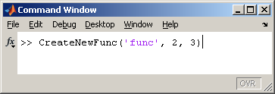
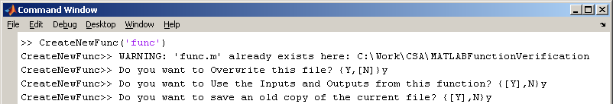
Function Generation
All CSA MATLAB Functions are CoSMO’d using CreateNewFunc
This function creates the desired function with all requisite internal documentation fields
Overall Description
Syntax
Breakdown of inputs and Outputs
Examples
Links to Source Documentation and related functions
By ensuring that all the requisite documentation fields are created, enables users to simply ‘fill-in-the-blanks’
Has added benefit of included sample display utilities
Has hooks to accommodate existing functions
Saves off a copy of the existing function before overwriting
CSA engineers would then copy over the original function’s core and documentation into the new file

Slide 4
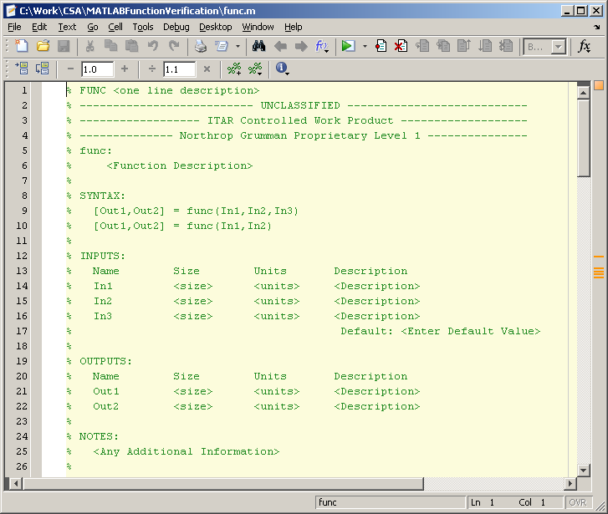
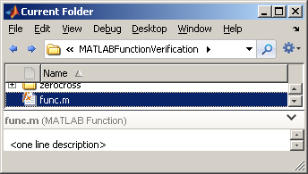
Header Information (1 of 2)
One Line Description for use in MATLAB’s folder view
Classification Markings
All possible permutations of how function can be called
Complete description of function
Breakdown of all inputs and outputs including their sizes (dimensions) and units
For overloaded functions, shows what the default values are if not provided

Slide 5
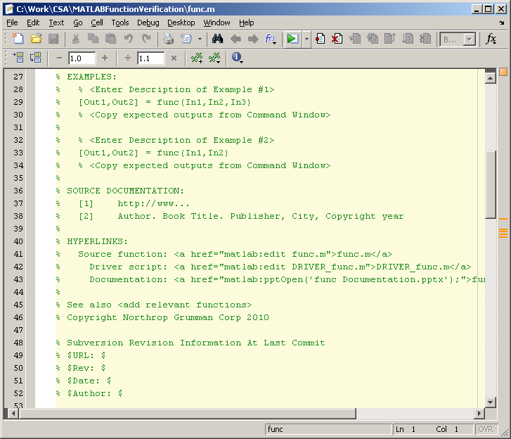
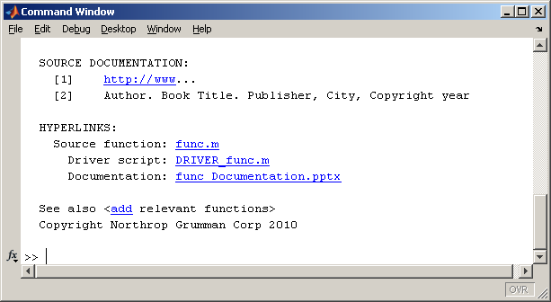
Header Information (2 of 2)
Sample function calls. If the syntax shows more than 1 method of calling function, this should show an example of each permutation
(e.g. with 2 inputs versus 3)
Cites where the function came from (books, journals, websites, tech fellows, etc.)
Sample hyperlinks to the actual function, the main test driver script, and any CSA documentation
Links to relevant functions
Tortoise SVN keyword information

Slide 6
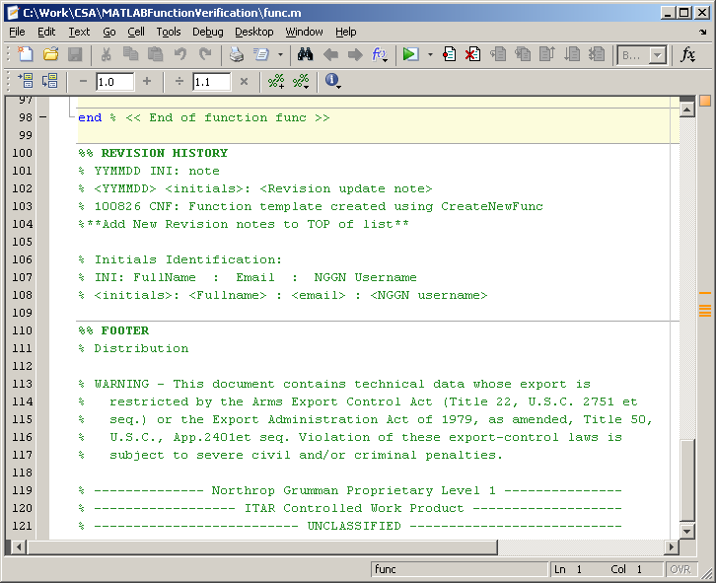
Footer Information
Revision History of file including bug fixes and enhancements
List of function’s authors complete with email and NGC username (5+2)
Complete distribution statement
Classification markings in reverse header order

